Slide 1
Making cents of your money

Slide 2
Dr. Marie Bakari
School of Business

Slide 3
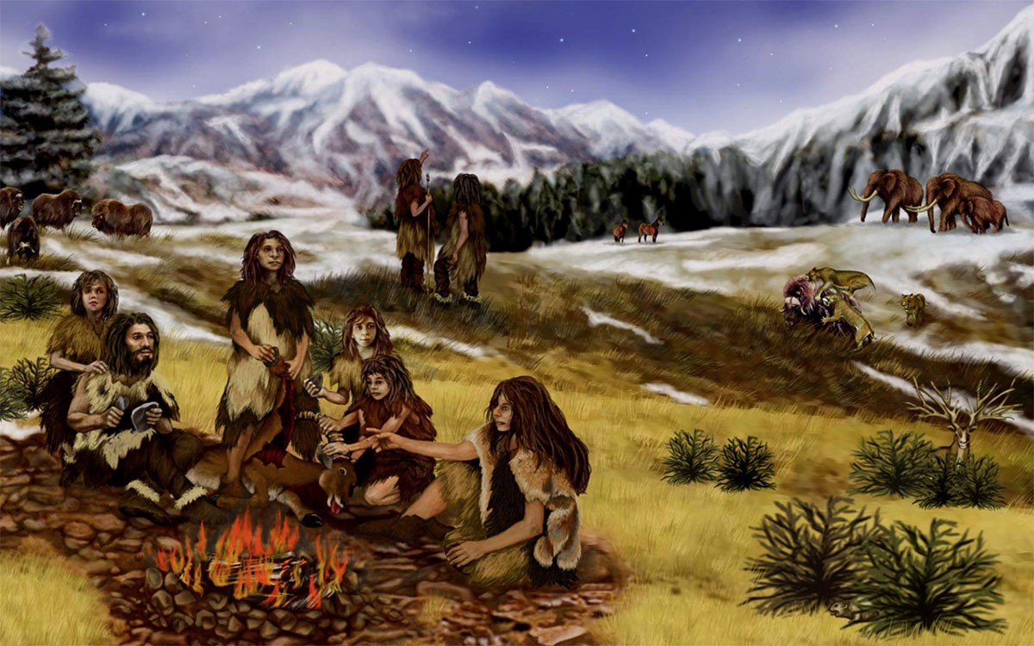
History of man and money
Hunting
&
Gathering
Notes:
We started as hunters and gatherers. This lifestyle was for folks who lived in small villages in isolated areas. There were scarce resources, little technology beyond stone tools.

Slide 4
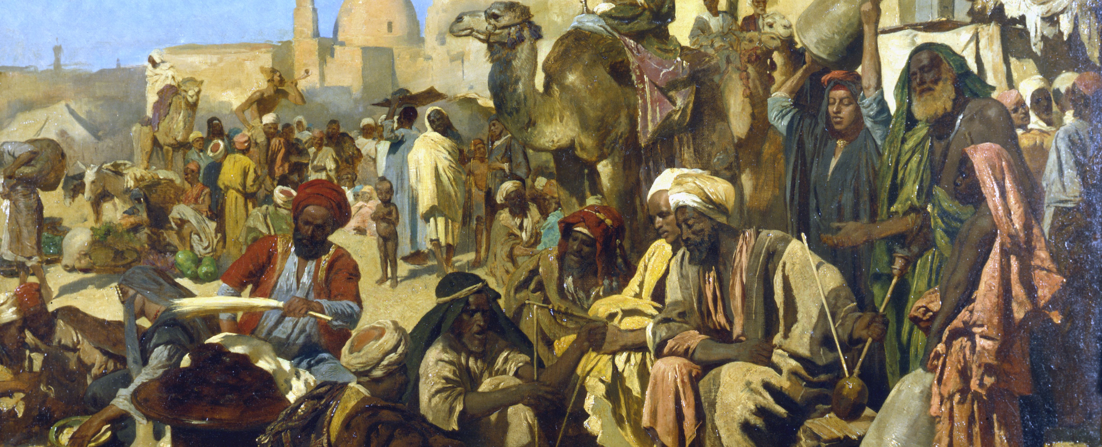
bartering
Exchanging goods for goods
Notes:
As populations grew and travel became commonplace, peoples from different areas began to trade goods for other goods.
Spices for teas, natural medicines for salts, minerals for ores and so on.

Slide 5
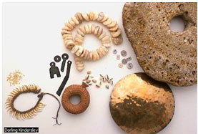
Markets & Coins
Exchanging shells, precious metals, or gems for goods
Notes:
Before the invention of coins and the doubloons pirates raided ships for on the open seas… an assortment of items were used in lieu of cash as we know it.

Slide 6
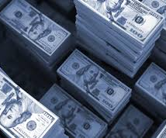
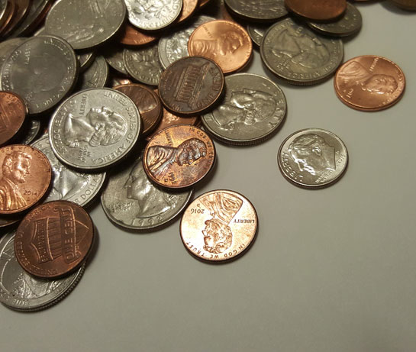
Cash as king

Slide 7
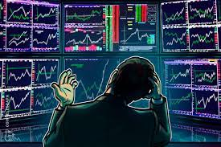
age of crypto

Slide 8
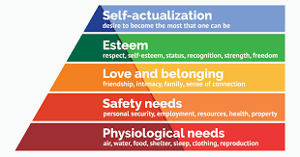
Maslow’s hierarchy

Slide 9
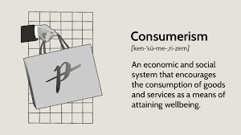
How we got from there to here
Notes:
Governments pushed consumerism around the world to stimulate economies after the devastation of 2 world wars. This has become a personal habit in progressive societies. Radio sponsorships, soap operas, marketing, advertising, social media, robo-calls, text notifications … we are inundated with efforts to continue this bad habit.
Some things to think about here.
We need drinking water to live, right? For what it costs us to purchase 6 cases of water, which equals roughly 30 gal., we could spend the same money on Amazon to purchase a water filter pitcher and reusable bottles and get over 100 gal. of great tasting drinking water.
This is a great example of smart consumerism.
Another example is cell phone service. Do we really need the latest and greatest? Especially if we are not travelling, lower rate services might do.

Slide 10
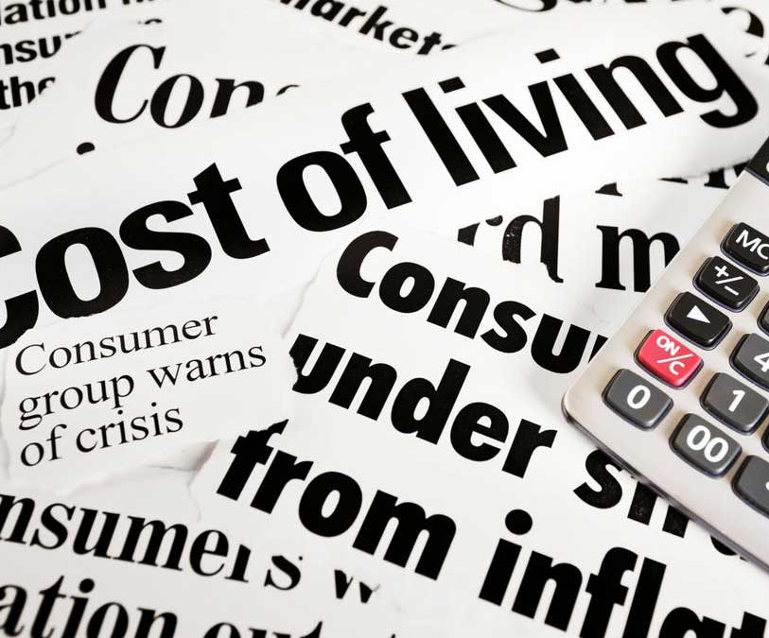
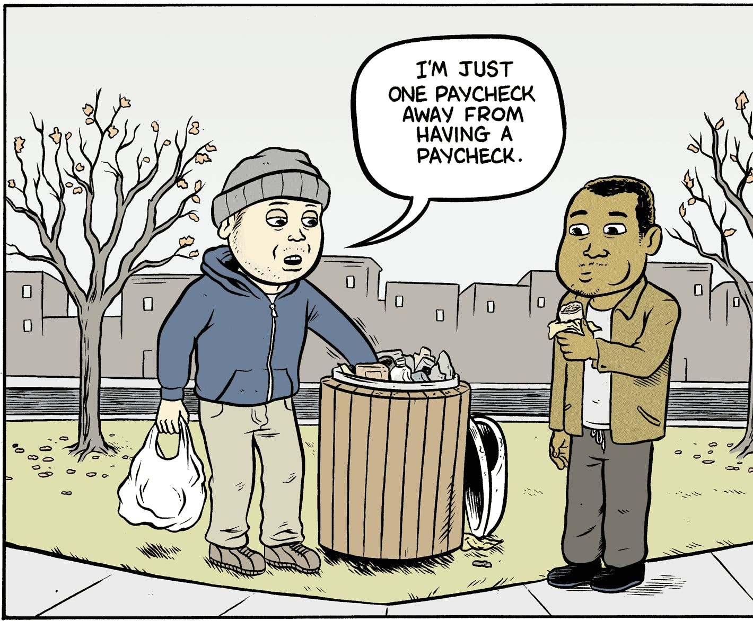
What’s our Reality?
Notes:
We hear a lot about inflation these days. The rule of thumb is, if gas prices go up, so does everything else. But there are some blessings in disguise here.
Since the onset of the Pandemic, some of our travel habits have changed – no traveling for work, grocery delivery services, Uber Eats is a thing.
Now that food is more expensive, we can refocus on nutrition needs and reproportion what we eat. Food ads are all around us, and fast food is so costly. Food is at the center of most celebrations, but we have to be smarter about what we consume for our overall health.

Slide 11
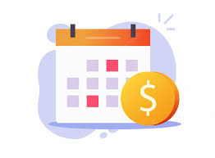
Simple Savings solution
Payday = pay bills
Easy on the extra spending
Limit eating out
Do I need it or want it?
Day before payday = TRANSFER DAY
Payday = start again

Slide 12
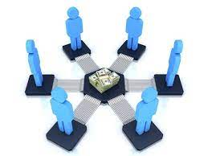
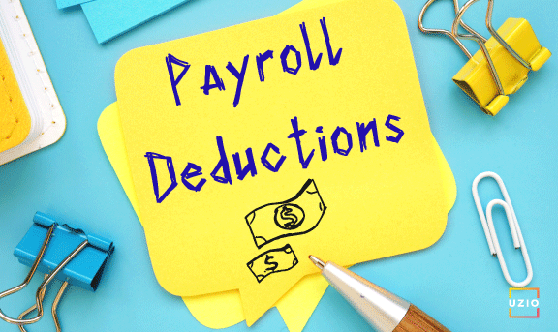
Saving money with accountability

Slide 13
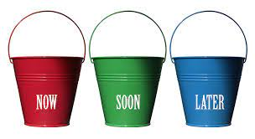
Managing funds
NOW – monthly expenses
Rent/mortgage
Groceries & utilities
SOON – Occasional expenses
Doctor’s visits
Auto/home repairs
3-6 months of income
LATER – Dreams and wishes
College funds
Retirement savings
Vacations
Bucket-list items

Slide 14
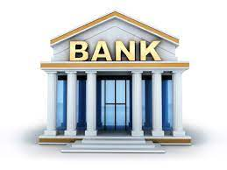
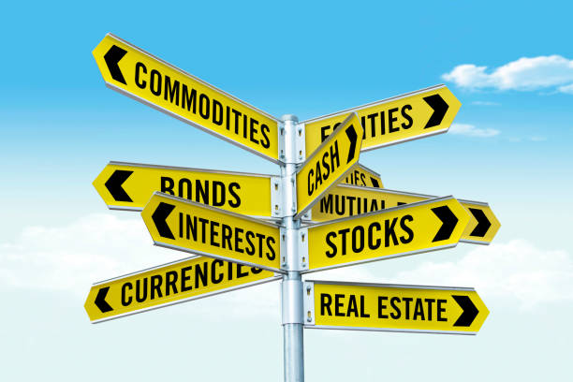


Professional Advisors

Slide 15
Survey Link

