Slide 1
Trauma Informed care:
Supporting Healthy Attachments
By:
Marsha Chase, PhD
Licensed Marriage and Family Therapist

Slide 2
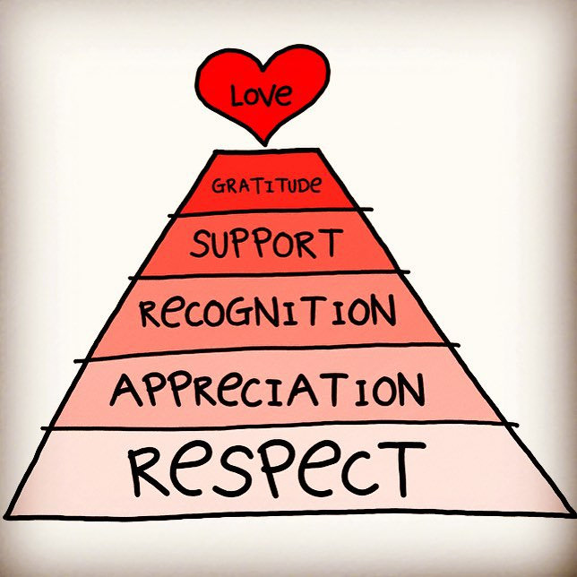
Attachments and Relationships
Relationship Questionnaire Loveisrespect.org
Video: https://binged.it/2BYRhY5
This Photo by Unknown Author is licensed under CC BY

Slide 3
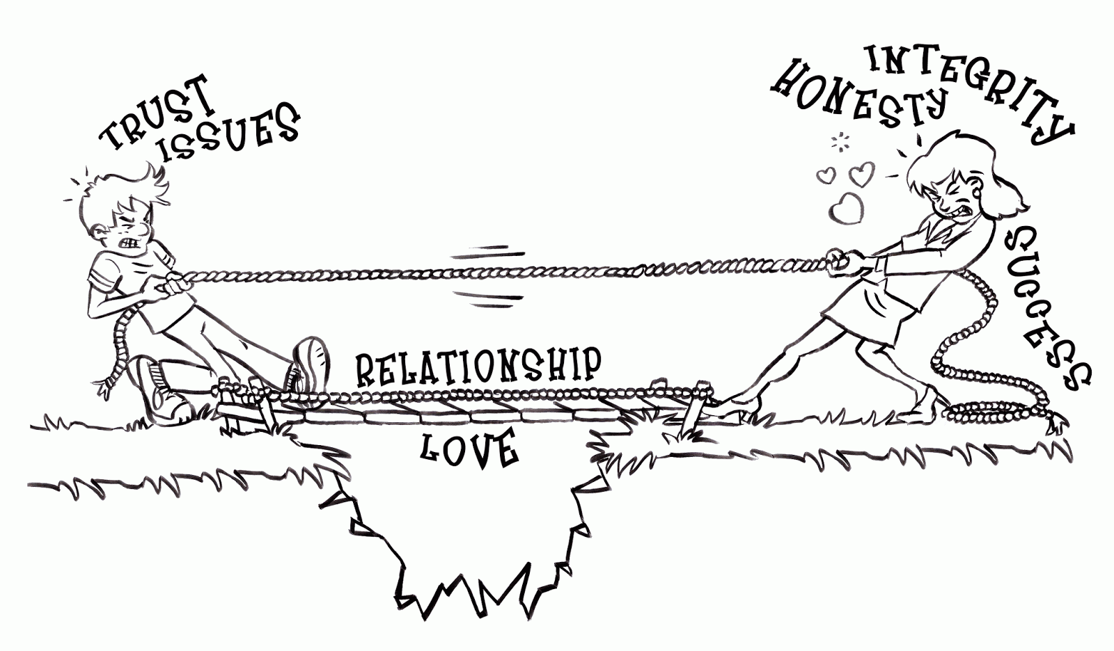
Attachment
Reactive Attachment Disorder (APA, 2022)
  Consistent pattern of inhibited and emotionally withdrawn behavior towards adult caregivers
    Rarely or minimally seeks or responds to comfort or care when distressed
  Persistent social and emotional disturbance
    Little ability to respond to others emotionally
    Little positive affect
    Periods of irritability, sadness, and fearfulness during unthreatening interactions with adults that are unable to be explained

Slide 4
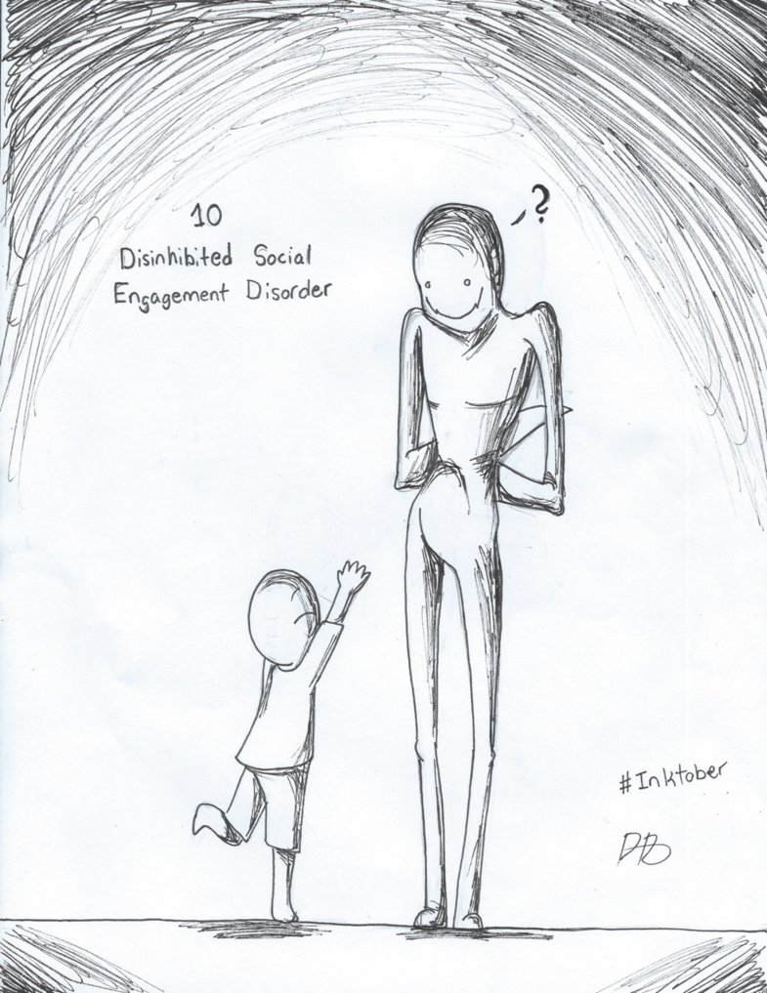
Attachment
Disinhibited Social Engagement Disorder (APA, 2022)
  Pattern of behavior where child actively approaches and interacts with unfamiliar adults
    Lack of fear in approaching and interacting with strangers
    Overly familiar verbal or physical behaviors (not age/developmentally appropriate)
    Lack of fear when without the caregiver
    Fearless willingness to go with unfamiliar adults/strangers
  Impulsive social behaviors and lack of attention and focus

Slide 5
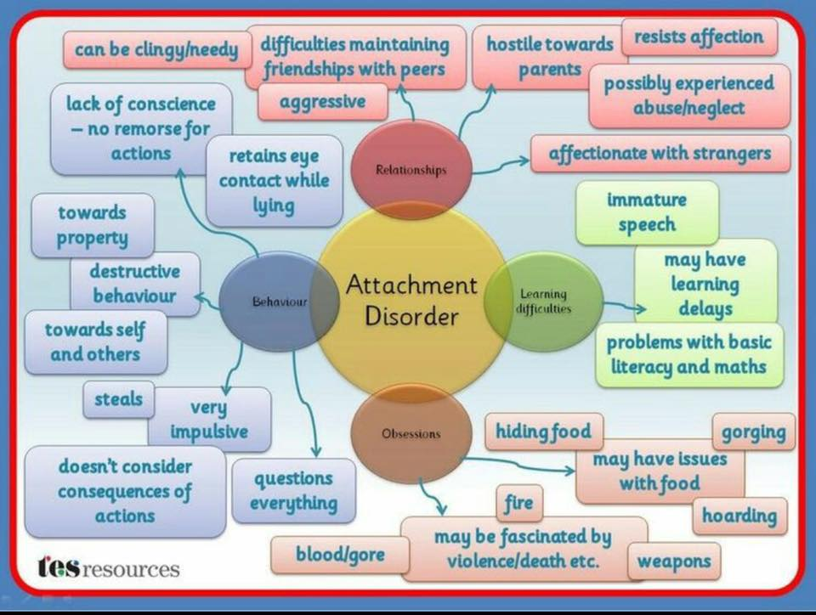
Attachment (APA, 2022)
Reactive Attachment Disorder and Disengaged Social Engagement Disorder
  Experienced a pattern of extreme insufficient care
    Social Neglect – lack of comfort, stimulation, and affection
    Repeated changes of primary caregivers
    Placed in settings that limit opportunities to form healthy attachments

Slide 6
Attachment Classifications (Smyke & Potter, 2011)
Secure – Person’s feelings are accepted and valued by the partner/caregiver
Insecure/Avoidant – Person’s feelings are not accepted. Values are for there to be independence and exploration.
Insecure/Resistant or Anxious (Simpson & Rholes, 2017) – Person is over-focused on the relationship
Disorganized – Partner/Caregiver should be a source of comfort but instead is a source of fear.

Slide 7

Why is attachment important (Bartlett et al, 2017; Blaustein & Kinniburgh, 2018; Kinniburgh et al, 2005)
1. Context for all development to begin
2. Develop ways of thinking from experiences with others about themselves
3. Attachments keep humans alive
4. Attachments develop a sense of self as worthy and competent
5. Attachments buffer the impacts of trauma
6. Attachment builds the world as SAFE

Slide 8
Trauma
Trauma (APA, 2022; Cohen et al, 2016) – When a person is exposed to actual or threatened death, serious injury, or sexual violence directly, by witnessing, by learning about the event, or having repeated exposure to details of event.

Slide 9
Trauma impacts (Cohen et al, 2016; Hodgdon et al, 2013)
Cognitive – Changes occur in the structure of the brain. Intrusive thoughts, nightmares, recurrent memories, and flashbacks.
Behavioral – Avoidance of thoughts, memories, feelings, or talking about the event. Verbal or physical aggression towards others or self, truancy from school, family conflict, drug and/or alcohol use, sexualized behavior or abuse towards others.
Affective – Sadness, fear, anxiety, or anger. There may be moodiness or difficulty in regulating emotions. These feelings can lead to self-harm, suicidal thoughts and even successful suicidal attempt.

Slide 10
Trauma: Core Concepts (National Child Traumatic Stress Center, 2012)
1. Traumatic Experiences are inherently complex
2. Trauma occurs within a broad context that includes the personal characteristics, life experiences and current circumstances.
3. Traumatic events often generate secondary adversities, life changes, and distressing reminders in daily life.
4. There can be a wide range of reactions to trauma and loss.
5. Danger and Safety are the core concerns in a traumatized person.
6. The experience affects the family and overall family systems.

Slide 11
Trauma: Core Concepts CONt.
7. Protective and promotive factors can reduce adverse impacts to trauma.
8. Trauma can adversely influence development.
9. Developmental neurobiology underlies reactions to experiences, such as fight, flight, freeze.
10. Culture impacts the response and recovery to traumatic experiences.
11. Legal and ethical issues impact response and recovery to the traumatic experience.
12. Working with trauma-exposed children can evoke distress in providers making it more difficult to provide good quality care.

Slide 12
The Attachment trauma complex (Purcell 1996; Smyke & Potter, 2011)
The sense of abandonment and attachment loss in itself is an underpinning of the feature of trauma.
Children form attachments with even the most impaired and harsh parents/caregivers!
Abusive
Neglectful
Depressed
Substance Abusing

Slide 13
Caregiver attachment behaviors
Determine (Blaustein & Kinniburgh, 2018)
1. Dysfunctional Attachment
2. Security
  Safety
  Exploration
  Support

Slide 14
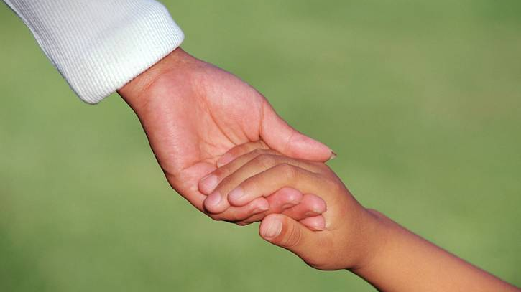
Rebuilding attachments
Becoming a Secure Base: Safety Net (Smyke & Potter, 2011)
  Work to become the child’s “Go To”
  Try to see from the child’s (other person’s) point of view
  Provide physical and psychological protection
  Support the person’s exploration while providing support
  Do not withdraw support if and when child acts out – Unconditional
  Label feelings
  Respond to your best guess as to the feelings
  Even if you don’t know what the person needs, it is important to try to show the unconditional care
This Photo by Unknown Author is licensed under CC BY-NC-ND

Slide 15
Building blocks: arc (Kinniburgh & blaustein, 2009)
Attachment
Regulation
Competence

Slide 16
Building blocks: arc (Kinniburgh & blaustein, 2009)
Attachment
  Caregiver affect management
    Caregiver is incorporated into treatment and encouraged to seek counsel for vicarious trauma
    Build and support in the moment regulation skills
    Tune into and notice successes
    Psychoeducation regarding trauma and attachment
    Teach affect management skills
    Encourage self-care

Slide 17
Building blocks: arc (Kinniburgh & blaustein, 2009)
  Attachment Cont
  2. Attunement
    Identifying, labeling, and coping with emotions
    Modeling and practicing language, touch, and response to emotions
    Trauma-informed response being aware of trauma related triggers.
  3. Consistent Response – Positive praise and reinforcement
  4. Routines and Rituals
    Build patterns and limits
    Build predictable routines for meals, bedtime, and treatment or therapy
    Be consistent with routines, schedules, and patterns
    Plan for changes

Slide 18
Building blocks: arc (Kinniburgh & blaustein, 2009)
Regulation
  Affect Identification – To build awareness of the internal experience, name emotion, and understand where it comes from
  Modulation – To help develop safe and effective strategies to manage and regulate emotions to a place where they feel comfortable (This can be a physical place or positive/pleasant imagery)
  Affect Expression – To help build skills and tolerance for effectively sharing emotions with others.

Slide 19
Building blocks: arc (Kinniburgh & blaustein, 2009)
Competence
  Executive Functioning: Problem Solving – To be able to act instead of react!!
  Self Development and Identity –
    Support in exploring and building a sense of self and personal identity
    Identifying positive qualities
    Coherence across time and experience
  Teaching developmental tasks
    Social Skills
    Motor Skills
    School Connections and Achievement
    Community Connections
    Independence, Responsibility, and Autonomy

Slide 20
Summary: Key factors
Build a team: Involve multiple persons across levels for support
Start small and build
Prioritize what matters the most. Is it worth the fight?
“Put on an oxygen mask” – A stressed system will struggle with being supportive
Consider the “real world” in building treatment targets
Be creative and individualized with ideas and treatment methods
Build resources and education

Slide 21

*Questions
Thank You
The End

Slide 22
References
American Psychiatric Association (2022). Diagnostic and statistical manual of mental disorders: Fifth edition: Text Revision: Trauma and stressor-related disorders. American Psychiatric Association. Retrieved from http:dx.doi.org/10.1176/appi.books.9780890425596.dsm07
Bartlett, J.D., Griffin, J.L., Spinazzola, J., Fraser, J.G., Noroña, C.R., Bodian, R., Todd, M., Motagna, C., & Barto, B. (2017). The impact of a statewide trauma-informed care initiative in child welfare on the well-being of children and youth with complex trauma. Children and Youth Services Review, 84, 110-117.
Blaustein, M. & Kinniburgh, K. (2018). Treating traumatic stress in children and adolescents: How to foster resilience through attachment, self-regulation, and competency, Second Edition. New York: Guilford Press.
Cohen, J., Deblinger, E., & Mannarino, A. (2016). Trauma-focused cognitive behavioral therapy for children and families. Psychotherapy Research. Doi: 10.1080/10503307.2016.1208375
Hodgdon, H., Kinniburgh, K., Gabowitz, D., Blaustein, M. & Spinazzola, J. (2013). Development and implementation of trauma-informed programming in residential schools using the ARC framework. Journal of Family Violence, 28, 679-692.
Kinniburgh, K. & Blaustein, M. (2009). Attachment, self-regulation, and competency (ARC): Applications of a components-based intervention model in residential settings. The Trauma Center at Justice Resource Institute. Retrieved from www.nctsn.org
Kinniburgh, K., Blaustein, M., Spinazzola, J., & van der Kolk, B. (2005). Attachment, self-regulation, and competency: A comprehensive intervention framework for children with complex trauma. Psychiatric Annals, 35(5), 424-430. Retrieved from www.nctsn.org
Purcell, W. (1996). The attachment-trauma complex. The American Journal of Psychoanalysis, 56(4), 435-446. Retrieved from ProQuest Central.
Simpson, J. A., & Steven Rholes, W. (2017). Adult Attachment, Stress, and Romantic Relationships. Current opinion in psychology, 13, 19–24. https://doi.org/10.1016/j.copsyc.2016.04.006
Smyke, A. & Potter, D. (2011). Issues of attachment for young traumatized children and their caregivers. The National Child Traumatic Stress Network. Retrieved from www.nctsn.org
The National Child Traumatic Stress Network. (2012). Core curriculum on childhood trauma: The 12 core concepts. The National Child Traumatic Stress Network. Retrieved from www.nctsn.org

